Slide 1
6th Grade
Language Arts
Mrs. Sullivan

Slide 2
Sixth Grade Language Arts Grading Policies
County-wide Grading Scale in use:
A = 90% and above
B = 80%-89%
C = 70%-79%
D = 60%-69%
F = 59% and below
Grade breakdown in Language Arts
70% Tests/Projects
30% Classwork/Homework/Participation
Homework: Check the week ahead
Always written in a different color
IXL/ Readworks/Classwork
Check Focus once a week

Slide 3
Structure of ELA Class
Sixth Grade Language Arts Curriculum
FLVS Language Arts
*Access in Modules via Canvas
We will work through these together. Quizzes and tests will be taken independently
*Read Aloud – Students are responsible for listening. Vocabulary and Comprehension
*Module Lesson
*Assignment- typically 1 per week

Slide 4
Helpful Information:
Some assignments are given through outside resources, such as Readworks, Quizziz and Brianpop
All codes and information are listed on the Canvas Homepage under codes
Make sure to check the week ahead to see if these assignments are due.
Passwords are typically MMS(lunch number)

Slide 5
ELA Class Routines/Procedures
When a student is absent
check the Week Ahead Picture (bottom of Homepage) This will tell you what is due and when
If a grade is marked with a 0 or Z
STUDENTS-communicate with your teacher (email or in person)
Extra Credit will be given once in the nine weeks period. Take advantage of it!!

Slide 6
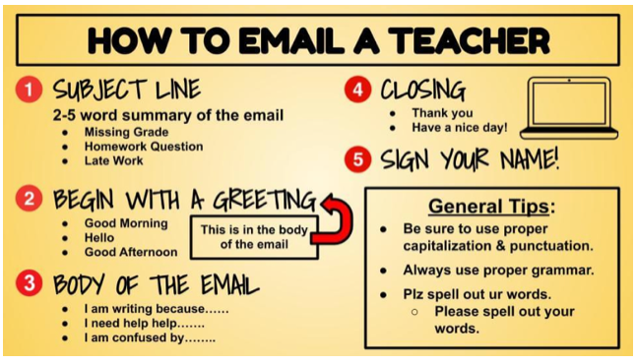
ALWAYS INCLUDE:
YOUR FIRST, LAST NAME, AND PERIOD #

Slide 7
What Parents Can Do
Encourage your child to keep up with the agenda. This can be your own planner, calendar or notebook of what is due and when
Assist with studying for tests by using the resources in the current Module.
Check FOCUS frequently. Late assignments will be accepted this first nine weeks.
Encourage your child to advocate for him/herself by asking questions and emailing the teacher directly when needed

